Slide 1

VALUE Framework
for Measuring L&D ROI
Worksheet

Slide 2
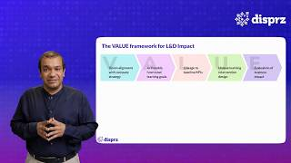
What is the VALUE framework ?
Clearly evaluate and define L&D programs against business goals
‹#›

Slide 3
The VALUE framework for L&D Impact
V
A
L
U
E
Vision alignment with company strategy
Actionable functional learning goals
Linkage to baseline KPIs
Unique learning intervention design
Evaluation of business impact
Notes:
This is good to go.

Slide 4
Enables clear evaluation of all L&D strategies against business goals
V
A
L
U
E
Vision alignment with company strategy
Actionable functional learning goals
Linkage to baseline KPIs
Unique learning intervention design
Evaluation of business impact
Examples
eCommerce co wants to grow from 100 to 1000 stations
Need to hire and onboard 50,000 delivery associates
Time to productivity:
4 weeks
Max scale:
1000 per week
New blended onboarded program over 2 days with 150 measurements
Time to productivity reduced to 2 weeks
Max scale:
5000 per week
Large retail brand
Improve store productivity
Average transaction value: AED 500
Basket size: 1.2
New sales activation program to improve share of wallet
Average transaction value: AED 800
Basket size: 1.8
Notes:
This is good to go.

Slide 5
Working Sheet (for users to fill)
V
A
L
U
E
Vision alignment with company strategy
Actionable functional learning goals
Linkage to baseline KPIs
Unique learning intervention design
Evaluation of business impact
Examples
Define Clear Objective
Define Outcome Goal for Business
Link KPI to Outcome
Define Learning Intervention
State Measurable Desired Impact
Notes:
This is good to go.

Slide 6
395 Pleasant Valley Way,
West Orange, NJ 07052, USA
www.disprz.ai

